Slide 1


Fabrication of graphitic-carbon suspended nanowires through mechano-electrospinning of photo-crosslinkable polymers
Osamu Katagiri-Tanaka A01212611@itesm.mx
Principal Advisor: Dr. Héctor Alán Aguirre Soto Co-advisor and Director of Program: Dra. Dora Iliana Medina Medina
01 Sep 2020

Slide 2
Agenda
<a point for discussion> : <5min
<another point for discussion> : ~20min

Slide 3
Motivation & Problem Statement

Slide 4
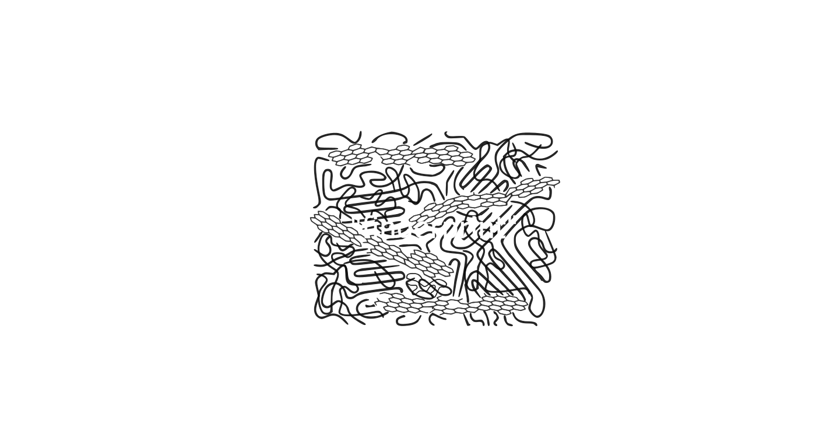
Carbon Based Nanomaterials (CBNs)
The crystallite size, molecular arrangement, and anisotropy determine the material’s properties.
The interminable collection of CBNs range from soft, conductive lubricants to very hard, low conductivity solids; and from black colour, bulks to transparent, disordered thin films
R.L. McCreery, Advanced Carbon Electrode Materials for Molecular Electrochemistry, Chem. Rev. 108 (2008) 2646–2687. https://doi.org/10.1021/cr068076m.
S. Beigi-boroujeni, O. Katagiri-tanaka, B. Cardenas-benitez, O. Sergio, A. Aguirre-soto, Pyrolytic Carbon from Novolac Epoxy Resin Compressed before Photocrosslinking and Pyrolysis, Mater. Today Proc. (2020).

Slide 5
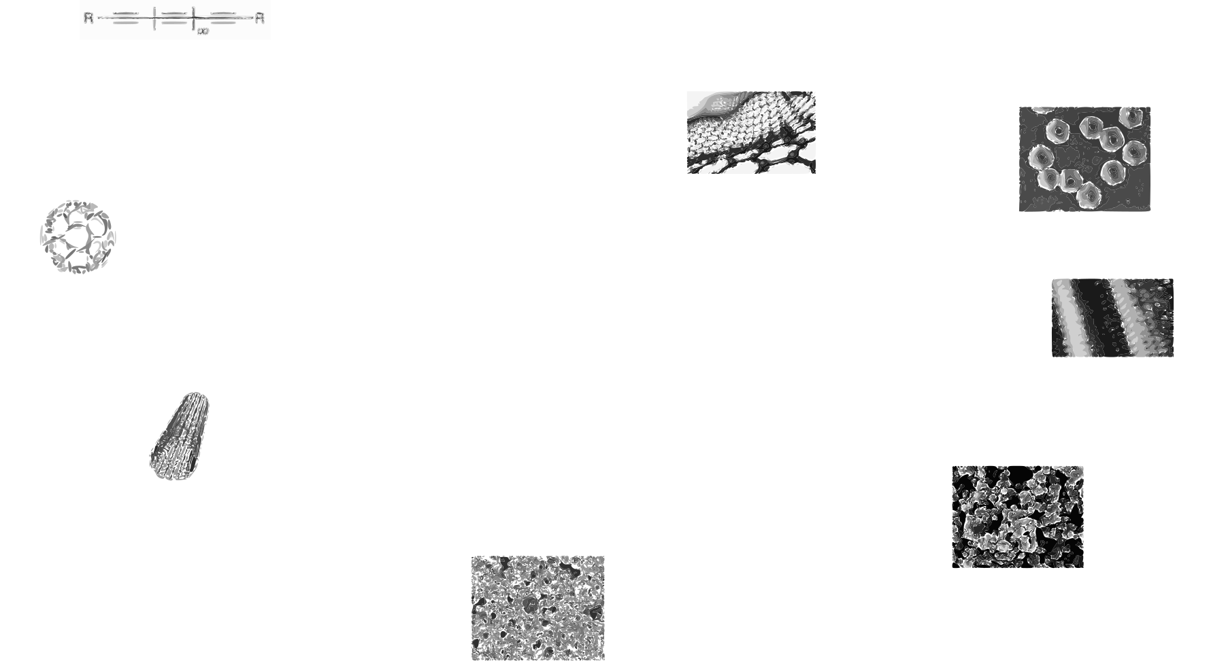
Side slide: Carbon allotropes
R.L. McCreery, Advanced Carbon Electrode Materials for Molecular Electrochemistry, Chem. Rev. 108 (2008) 2646–2687. https://doi.org/10.1021/cr068076m.
S. Beigi-boroujeni, O. Katagiri-tanaka, B. Cardenas-benitez, O. Sergio, A. Aguirre-soto, Pyrolytic Carbon from Novolac Epoxy Resin Compressed before Photocrosslinking and Pyrolysis, Mater. Today Proc. (2020).

Slide 6
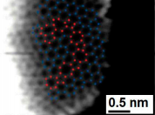
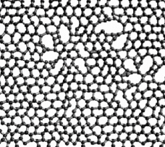
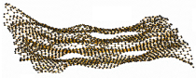
Glass-like Carbon
Attractive for its electrochemical stability, thermal resistance, electrical conductivity, biocompatibility and is gas impermeable.
It is used in the manufacture of semiconductors.
R.L. McCreery, Advanced Carbon Electrode Materials for Molecular Electrochemistry, Chem. Rev. 108 (2008) 2646–2687. https://doi.org/10.1021/cr068076m.
G. Speranza, The Role of Functionalization in the Applications of Carbon Materials: An Overview, C — J. Carbon Res. 5 (2019) 84. https://doi.org/10.3390/c5040084.

Slide 7
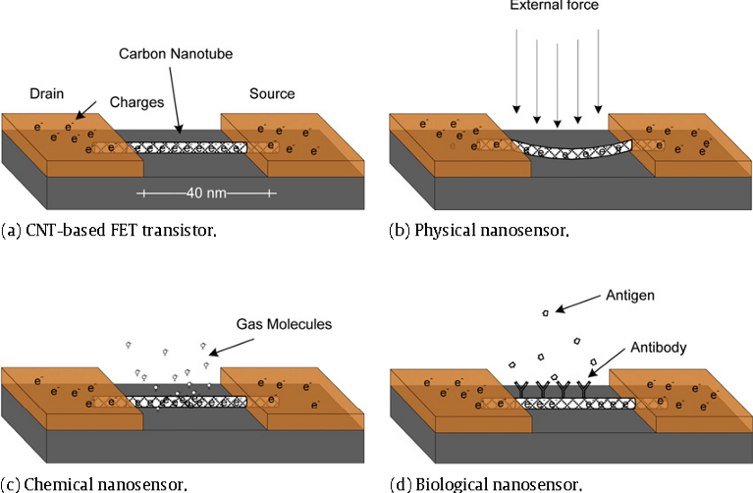
Glass-like Carbon NWs: Applications
R.L. McCreery, Advanced Carbon Electrode Materials for Molecular Electrochemistry, Chem. Rev. 108 (2008) 2646–2687. https://doi.org/10.1021/cr068076m.
G. Speranza, The Role of Functionalization in the Applications of Carbon Materials: An Overview, C — J. Carbon Res. 5 (2019) 84. https://doi.org/10.3390/c5040084.

Slide 8
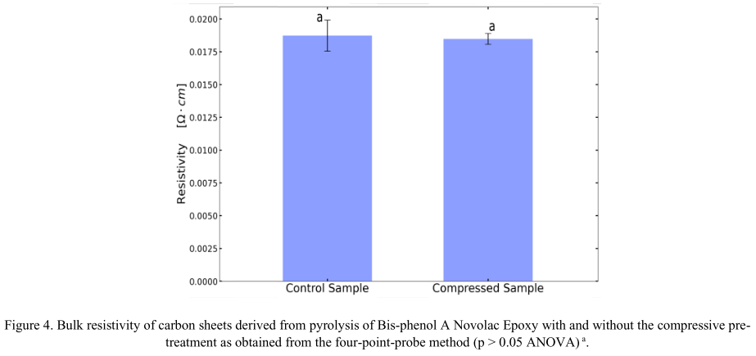
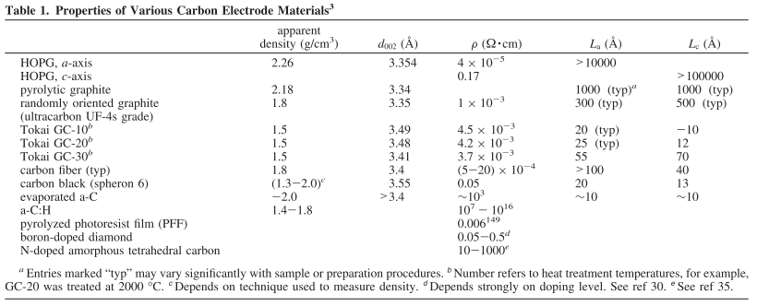
MicroChem’s SU-8 & Tokai’s recipe
SU-8
glass-like carbon resistivity:
<content> <key concept>
R.L. McCreery, Advanced Carbon Electrode Materials for Molecular Electrochemistry, Chem. Rev. 108 (2008) 2646–2687. https://doi.org/10.1021/cr068076m.
G. Speranza, The Role of Functionalization in the Applications of Carbon Materials: An Overview, C — J. Carbon Res. 5 (2019) 84. https://doi.org/10.3390/c5040084.

Slide 9


MicroChem’s SU-8 & Tokai’s recipe
SU-8
glass-like carbon resistivity:
Electrical resistivity, comparison:
highly oriented pyrolytic graphite (HOPG)
<
<
TOKAI Glassy carbon
SU-8 glass-like carbon
10^3
x4
<content> <key concept>
R.L. McCreery, Advanced Carbon Electrode Materials for Molecular Electrochemistry, Chem. Rev. 108 (2008) 2646–2687. https://doi.org/10.1021/cr068076m.
G. Speranza, The Role of Functionalization in the Applications of Carbon Materials: An Overview, C — J. Carbon Res. 5 (2019) 84. https://doi.org/10.3390/c5040084.

Slide 10
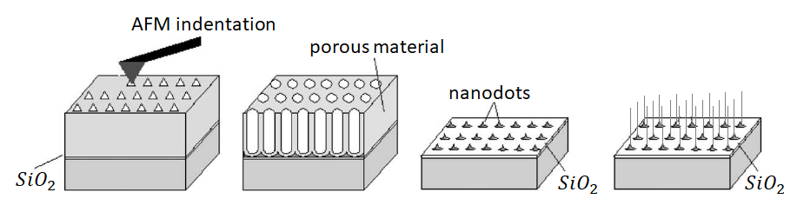
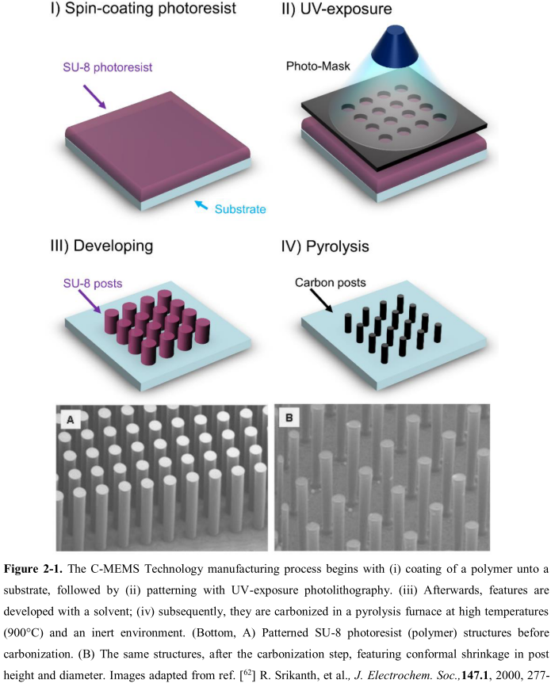
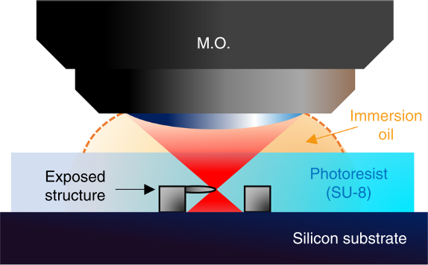
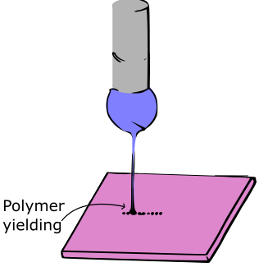
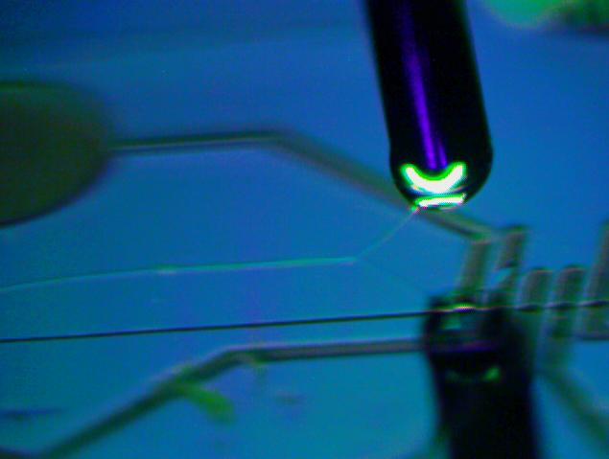
Current approaches
Self-assembly
Limited Length and Random Orientation
Photolithography
Physical & Optical Limitations
Two-Photon Polymerization (TPP)
Slow (mm per sec) & Expensive
* Near-Field Electrospinning (NFES)
Suspended Nanowires w/Spatial Control
V. Galstyan, M. Bhandari, V. Sberveglieri, G. Sberveglieri, E. Comini, Metal Oxide Nanostructures in Food Applications: Quality Control and Packaging, Chemosensors. 6 (2018) 16. https://doi.org/10.3390/chemosensors6020016.
D. Kluge, J.C. Singer, B.R. Neugirg, J.W. Neubauer, H.-W. Schmidt, A. Fery, Top–down meets bottom–up: A comparison of the mechanical properties of melt electrospun and self-assembled 1,3,5-benzenetrisamide fibers, Polymer (Guildf). 53 (2012) 5754–5759. https://doi.org/10.1016/j.polymer.2012.10.016.

Slide 11

MicroChem’s SU-8
Pyrolysis of SU8 is currently the typical method to produce glass-like carbon.
Polymer patterning through photolithography
Carbonization through pyrolysis
However, photolithography generates waste in the spin-coating and developing steps. Also, it presents physical & optical limitations to the carbon structures
Limitations can be overcome with other fabrication techniques, such as NFES
Microchem, Su-8 2000.5-2015, 2000.5, 2002, 2005, 2007, 2010, 2015. (2006) 1–5. papers3://publication/uuid/859F51B9-0382-4DE8-88A9-267F936939A3.

Slide 12
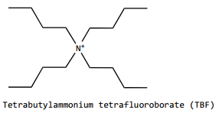
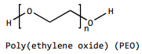
MicroChem’s SU-8
However, SU-8 as is can not electrospin
SU-8 does not have the right viscosity & solution conductivity.
SU-8 is design for photolithography.
SU-8 + TBF + PEO
To increase the solution conductivity
To provided the required viscosity
… both needed for smooth PEO flow during electrospinning
D.R. Flores, Role of rheological properties in near field electrospun fibers morphology, (2017) 130.
B. Cárdenas Benítez, Advanced Manufacturing Techniques for the Fabrication and Surface Modification of Carbon Nanowires, Tecnológico de Monterrey, 2017.

Slide 13
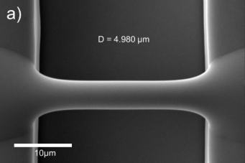
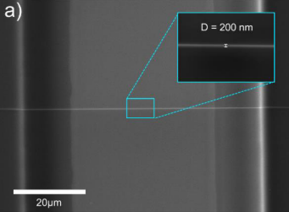
Best Results so far by NFES by Braulio & Ricardo
Fiber yield rate of 81 %
Fiber diameter before pyrolysis of 4.966 μm
Fiber diameter after pyrolysis of 204 nm
Fiber length of 60.5 ± 4.3 μm
Fiber resistance from 407 KΩ to 1.727 MΩ
wt% PEO 0.25 | SU-8 2002 [mg] | PEO [mg] | TBF [mg]
 | 2246 | 5.65 | 11.32
D.R. Flores, Role of rheological properties in near field electrospun fibers morphology, (2017) 130.
B. Cárdenas Benítez, Advanced Manufacturing Techniques for the Fabrication and Surface Modification of Carbon Nanowires, Tecnológico de Monterrey, 2017.

Slide 14
Implications of PEO
The fiber yield rate and fiber conductivity are impacted negatively as PEO introduces more oxygen to the solution
Some samples are destroyed during pyrolysis
High variance in the obtained conductivity across samples.
The addition of oxygen decreases the char yield.
D.R. Flores, Role of rheological properties in near field electrospun fibers morphology, (2017) 130.
B. Cárdenas Benítez, Advanced Manufacturing Techniques for the Fabrication and Surface Modification of Carbon Nanowires, Tecnológico de Monterrey, 2017.

Slide 15
Objectives

Slide 16
Objectives
General. Study the feasibility of NFES in the fabrication of glass-like carbon nanowires.
Specific1. Replace the SU-8 photoresist with a new polymer solution that can be electrospun by NFES, photopolymerized, and then pyrolyzed.
Specific2. Determine if polymer solutions can be easily employed for conducting carbon nano-wire production through rheological analyses.
Specific3. Discover a similar PEO-SU8-TBF material to allow the electrospinning process as well as input favourable properties to the carbon nanowire yield.

Slide 17
NFES literature review
Specific Objective 1. Replace the SU-8 photoresist with a new polymer solution that can be electrospun by NFES, photopolymerized, and then pyrolyzed.

Slide 18
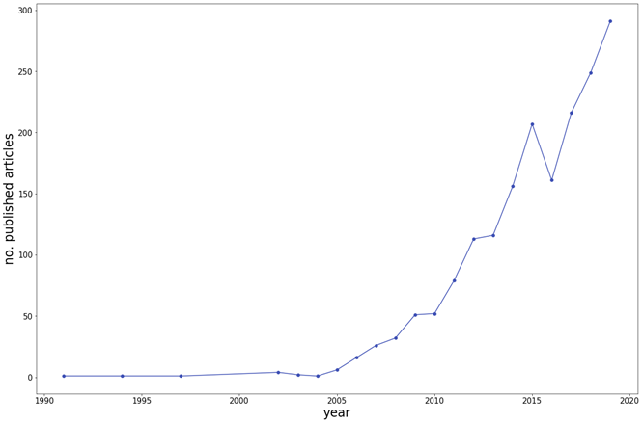
Methods: History of NFES literature (first NFES apparatus built in 2003 by J. Kameoka et al.)
Thinnest fiber achieved by C. Chang et al. with ~50 nm in diameter. (PEO in water)
However, fiber yield rate was not reported
J. Kameoka, R. Orth, Y. Yang, D. Czaplewski, R. Mathers, G.W. Coates, H.G. Craighead, A scanning tip electrospinning source for deposition of oriented nanofibres, Nanotechnology. 14 (2003) 1124–1129. https://doi.org/10.1088/0957-4484/14/10/310.
C. Chang, K. Limkrailassiri, L. Lin, Continuous near-field electrospinning for large area deposition of orderly nanofiber patterns, Appl Phys Lett. (2008) 3. https://doi.org/10.1063/1.2975834.

Slide 19
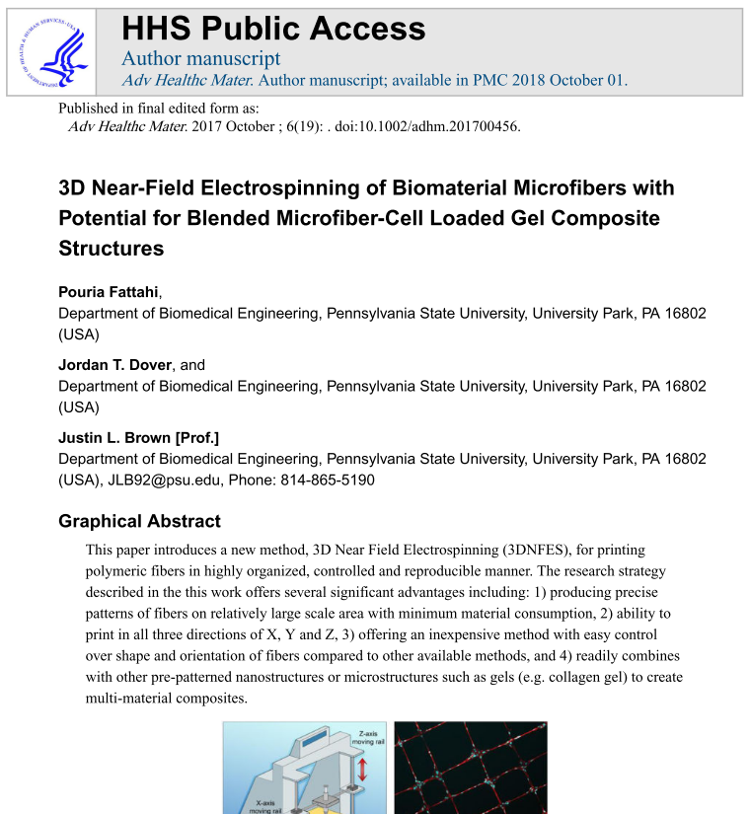
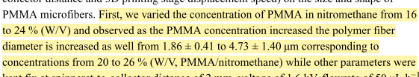
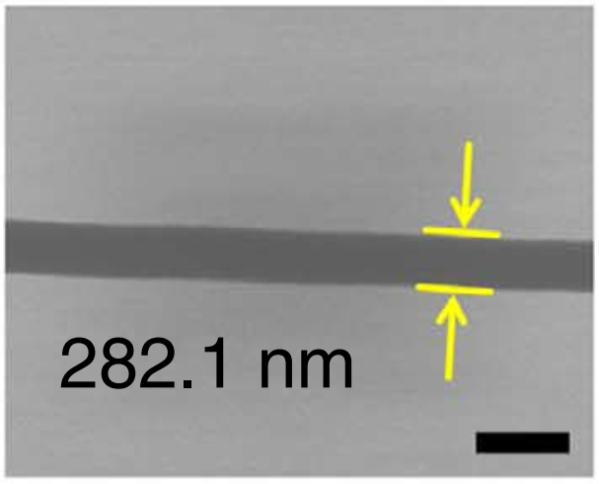
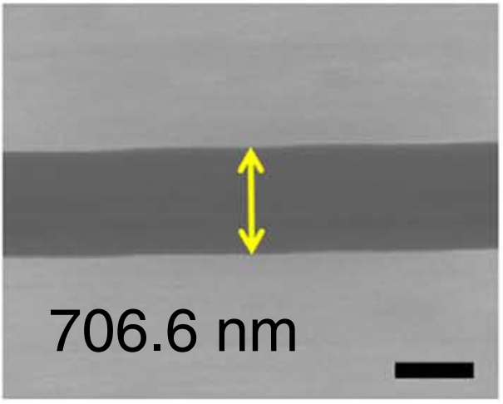
Methods: Data collection (analysis of NFES articles from 2003 to 2020)
Use case 1 (ideal case): The author mentions the process parameters and fiber properties within the article in writing.
Fattahi2017
Figures from Min2013

Slide 20
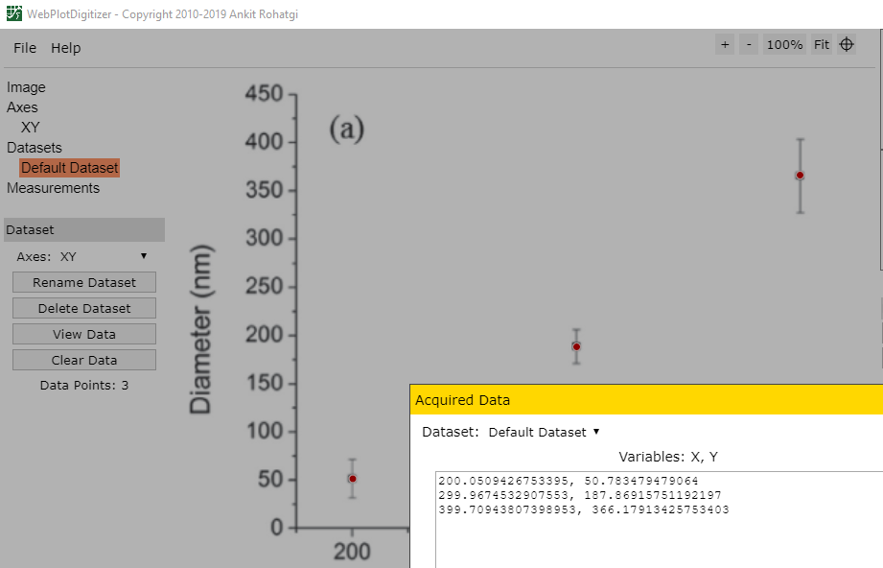
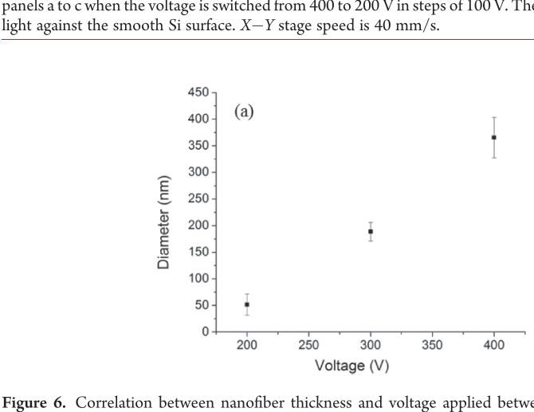
Methods: Data collection (analysis of NFES articles from 2003 to 2020)
Use case 2 (typical case): The author provides the data in plots and graphs.
WebPlotDigitalizer (https://github.com/ankitrohatgi/WebPlotDigitizer):
M.J. Madou, D. Dunn-Rankin, L. Kulinsky, A. Mirsepassi, G.S. Bisht, S. Oh, G. Canton, Controlled Continuous Patterning of Polymeric Nanofibers on Three-Dimensional Substrates Using Low-Voltage Near-Field Electrospinning, Nano Lett. 11 (2011) 1831–1837. https://doi.org/10.1021/nl2006164.
Applied voltage vs. fiber diameter by Madou2011

Slide 21
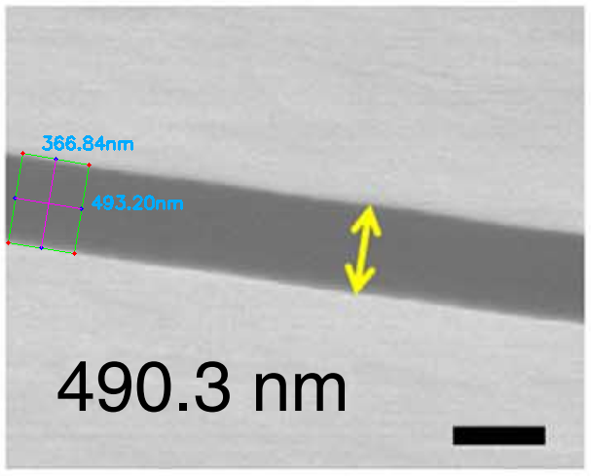
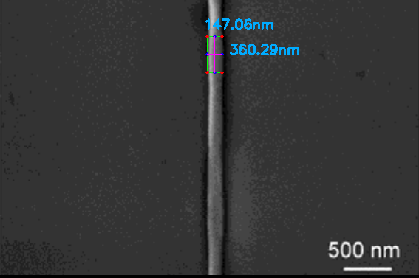
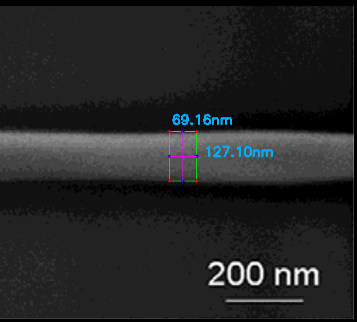
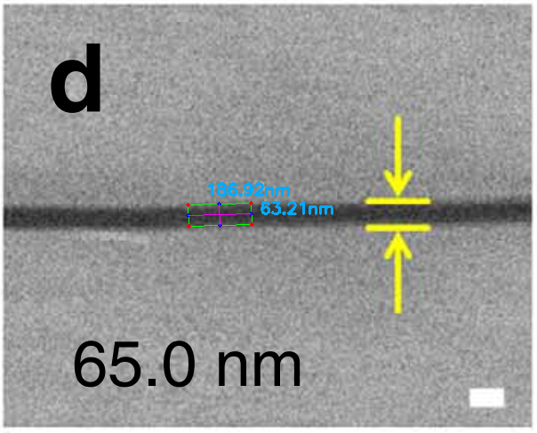
Methods: Data collection (analysis of NFES articles from 2003 to 2020)
Use case 3 (difficult case): The author does not mention the fiber diameter in writing but provides a EM characterization.
Python Image Analysis (with a 4.3% error in avg.):
Figure from Camillo2013
Figures from Min2013
Figure from Camillo2013
https://github.com/katagirimx/OpenCV-image-measuring

Slide 22
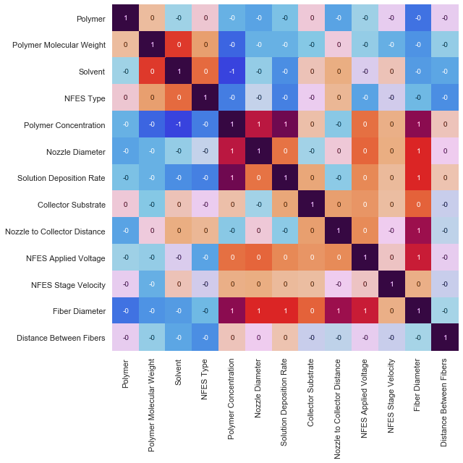
Conclusion 1.1:
Polymer Concentration,
Nozzle Diameter,
Solution Deposition Rate,
Nozzle to Collector Distance &
Applied Voltage
are the main drivers of the final Fiber Diameter

Slide 23
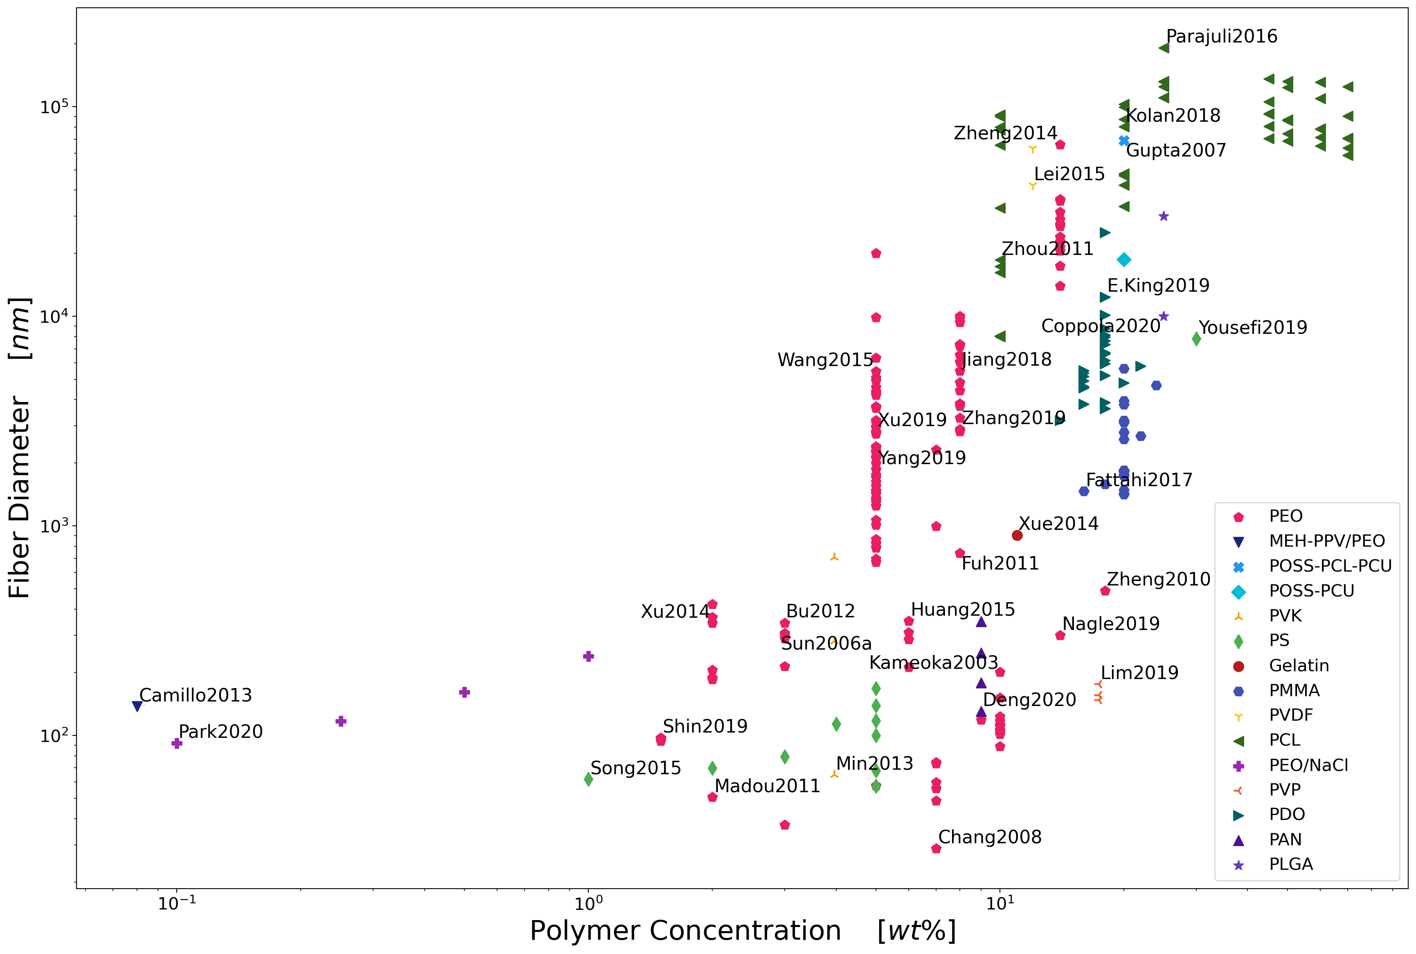
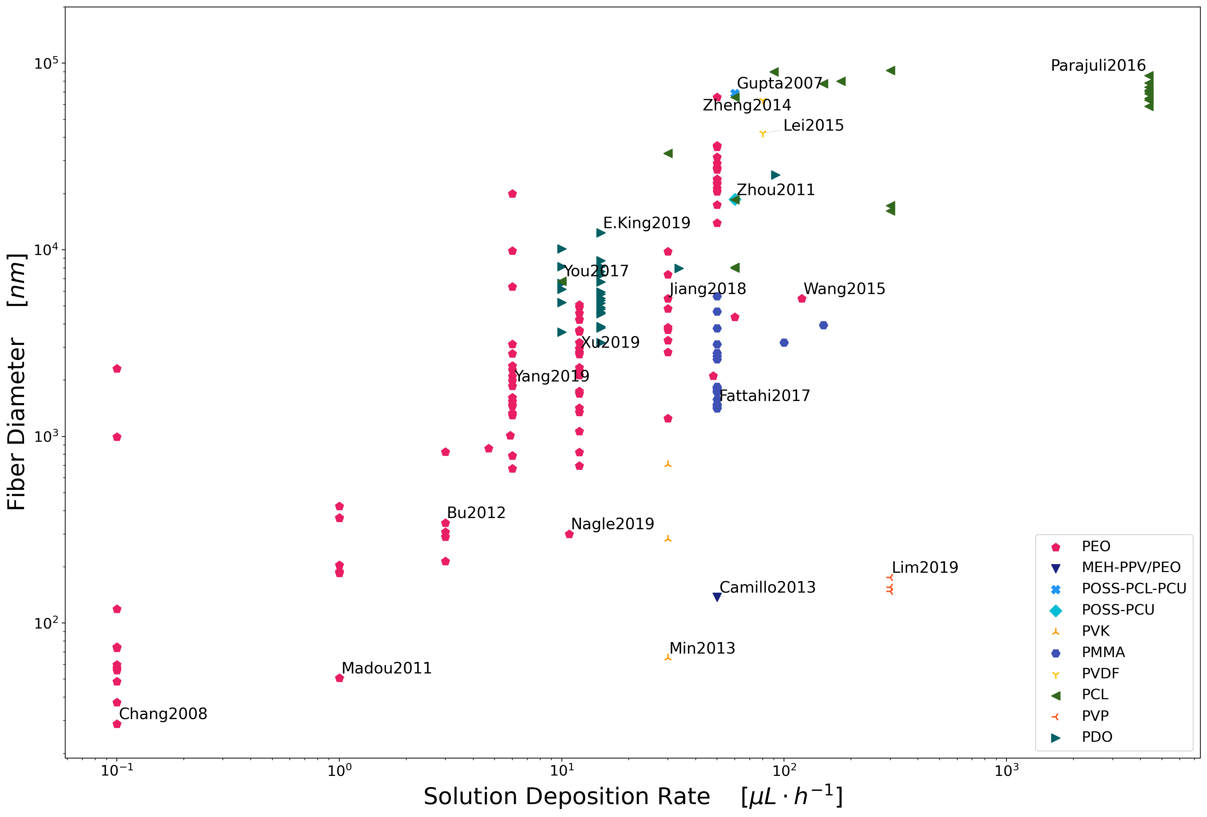
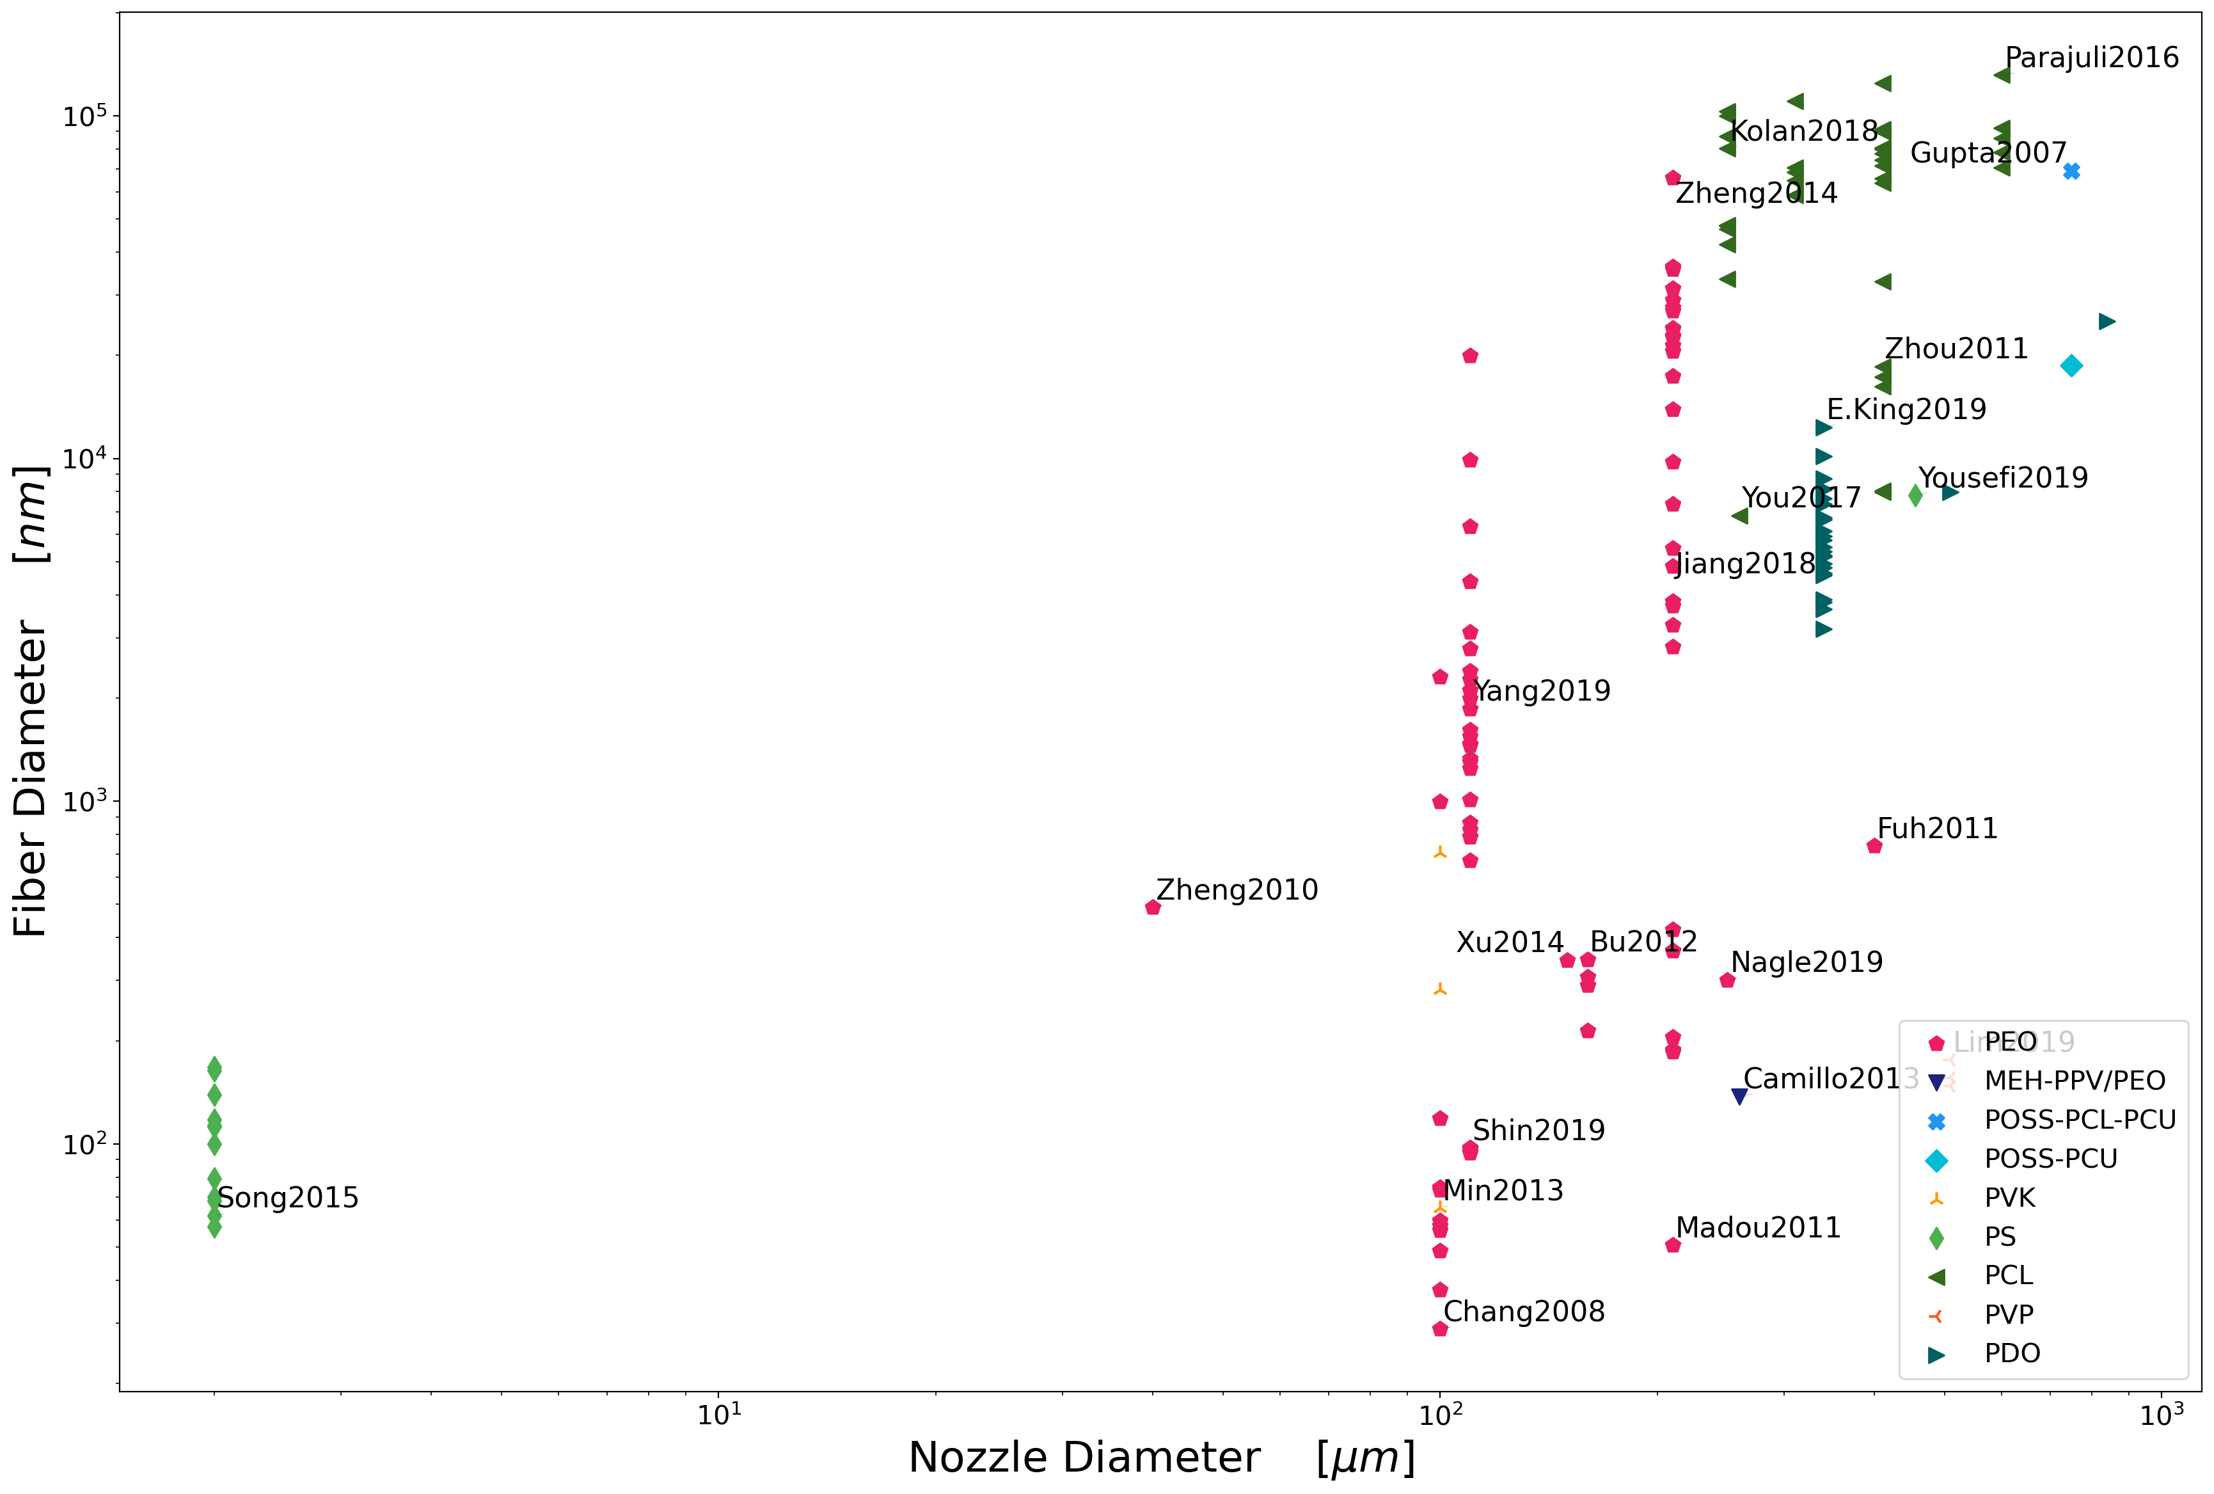
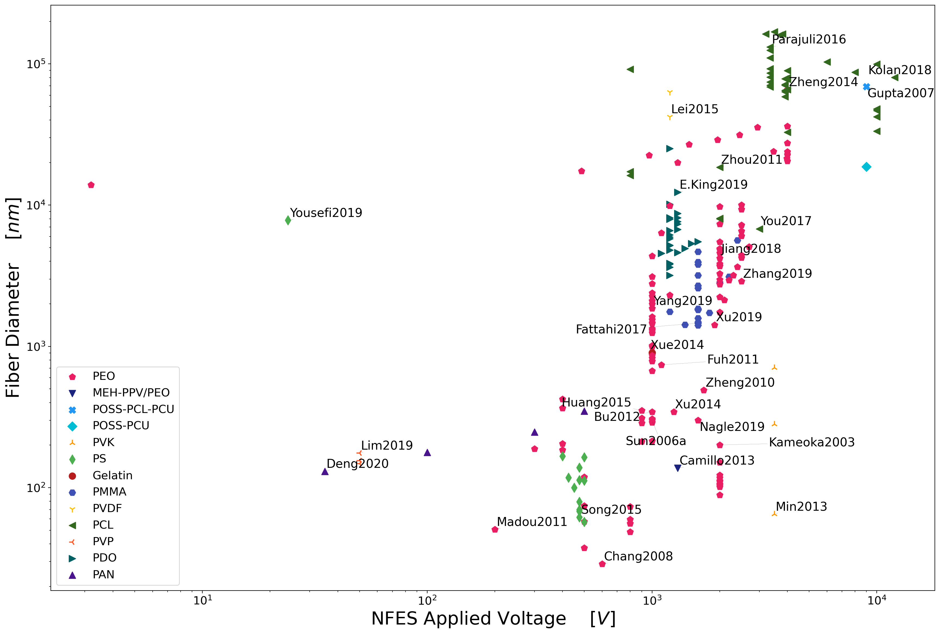
low polymer concentrations
slow solution deposition rates
Conclusion 1.1:
Process Parameters
small nozzle
diameters
low voltages
23

Slide 24
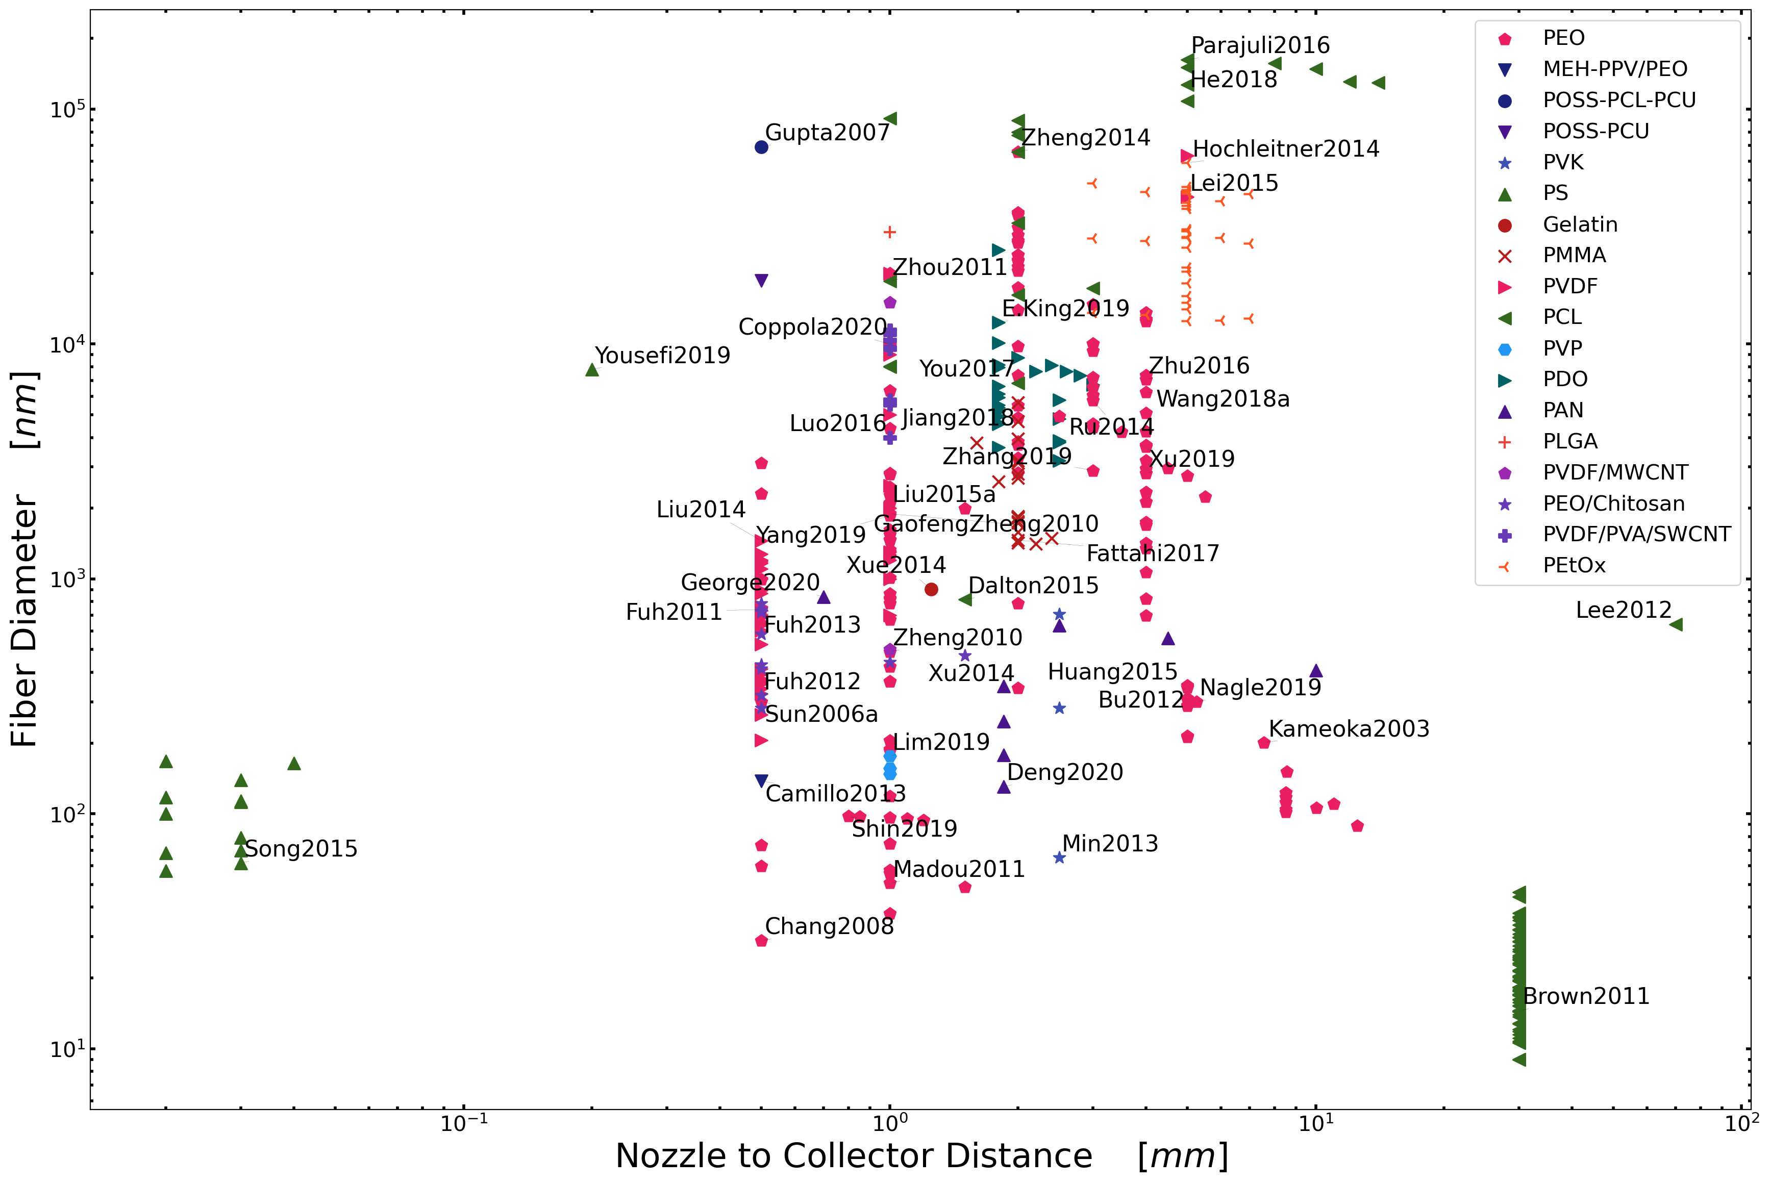
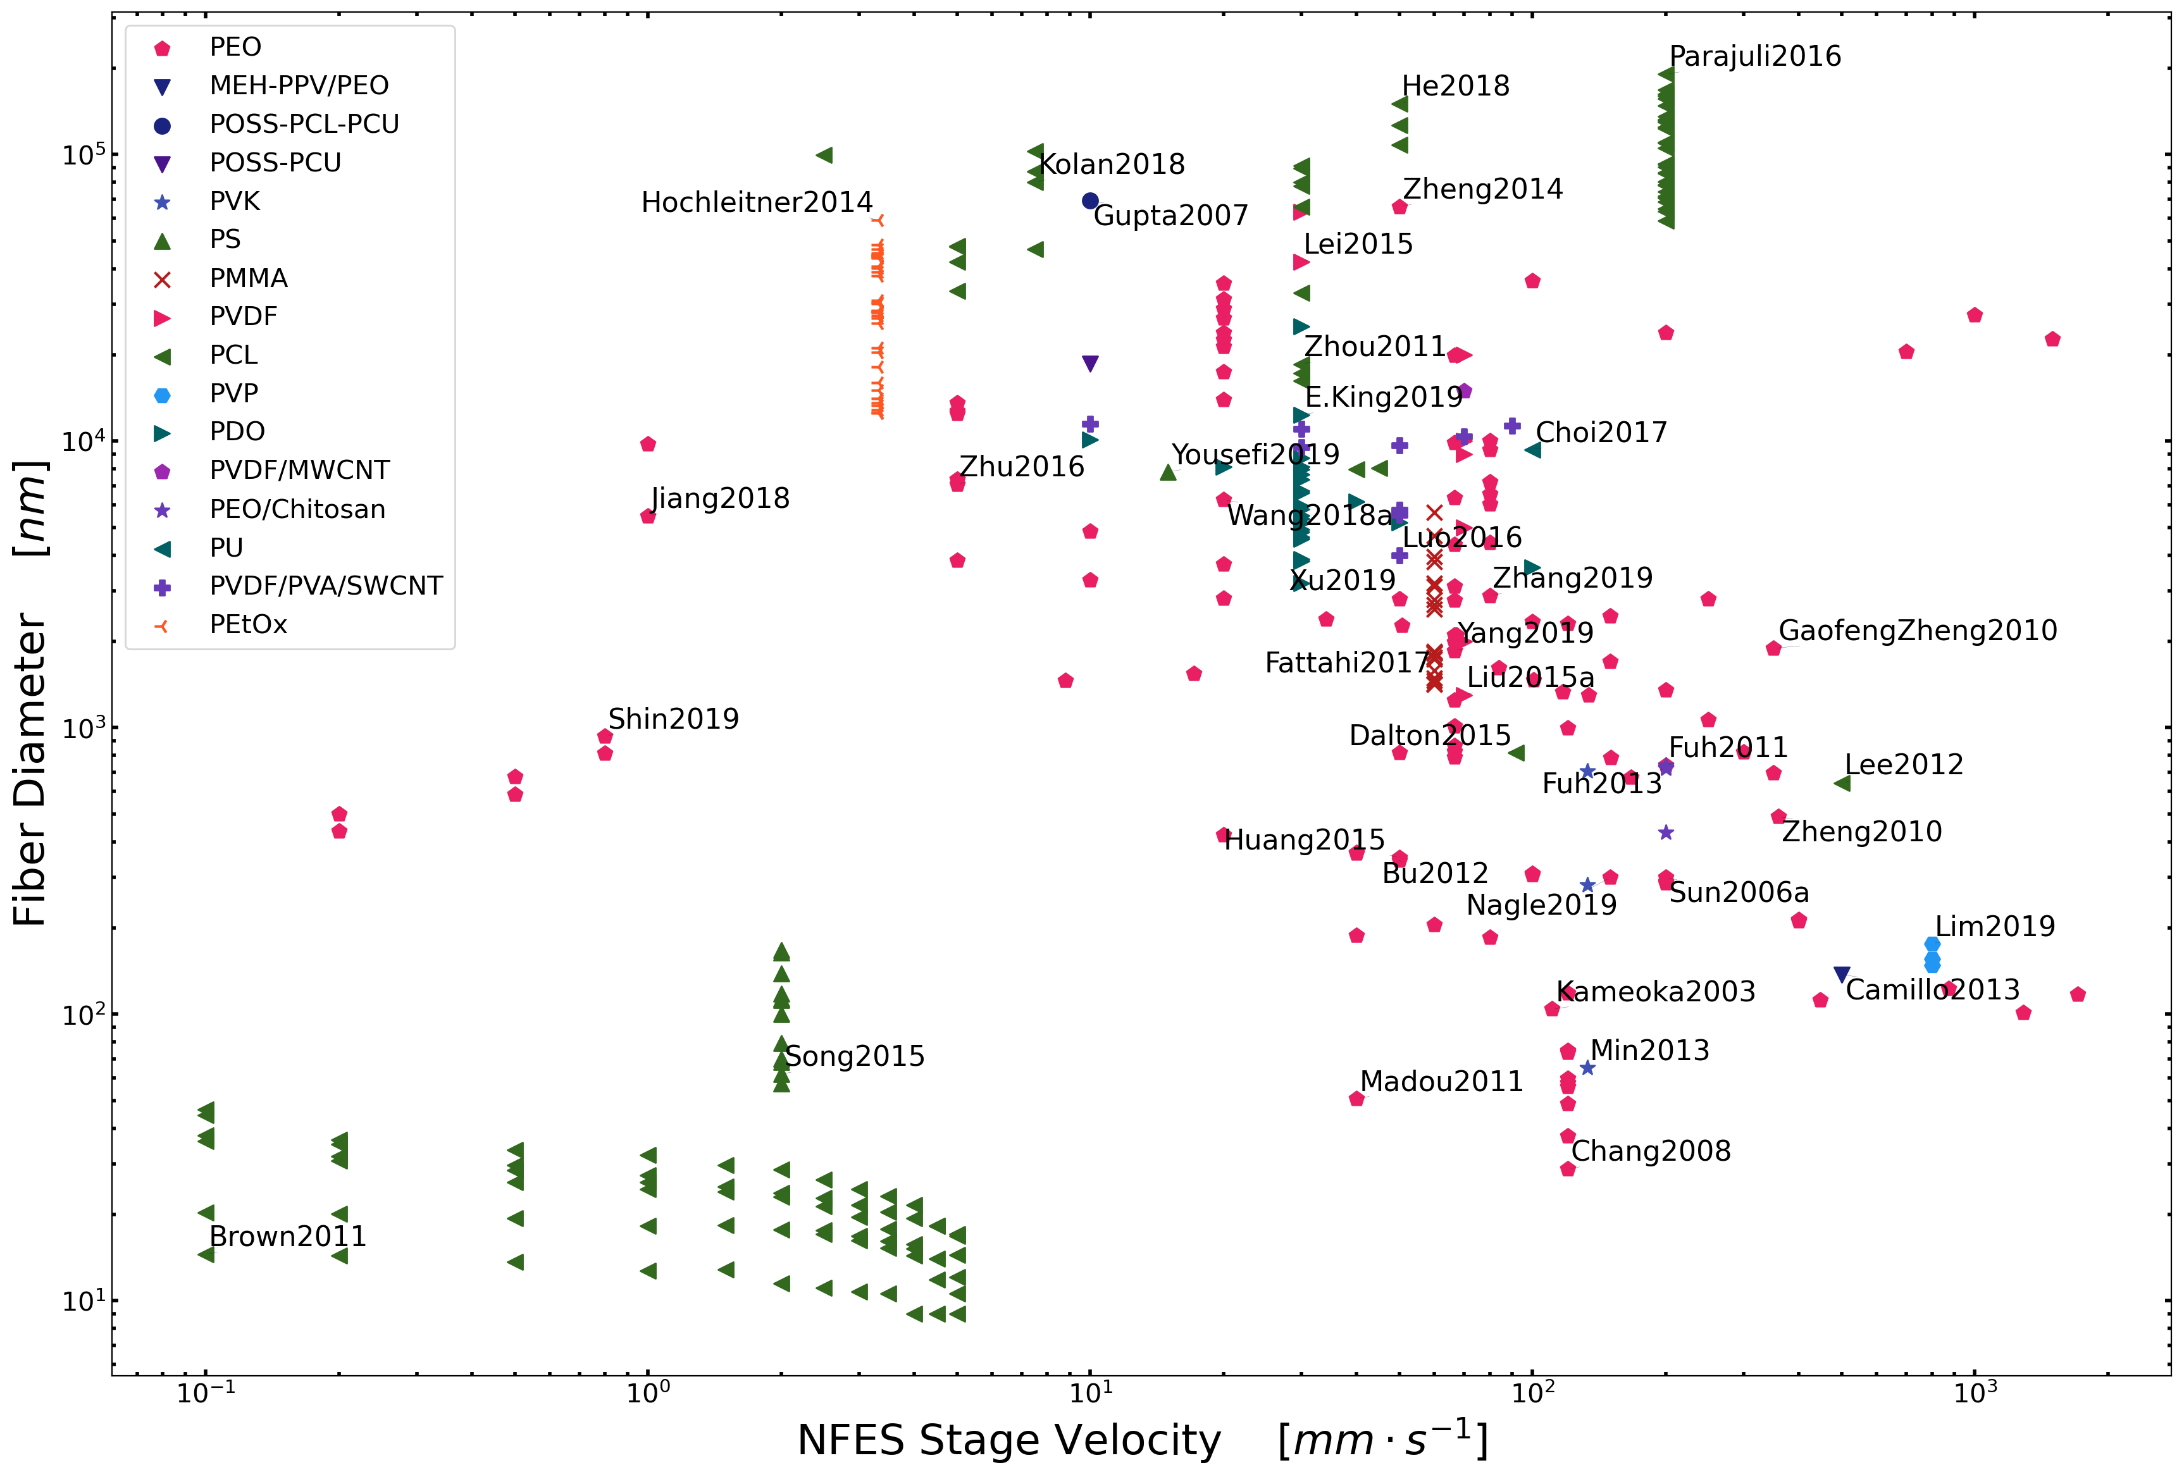
Conclusion 1.2: Let’s focus on polymer concentration
Polymer concentration is the most reliable process parameter to control the morphology of electrospun fibers. (regardless the type of NFES process)

Slide 25
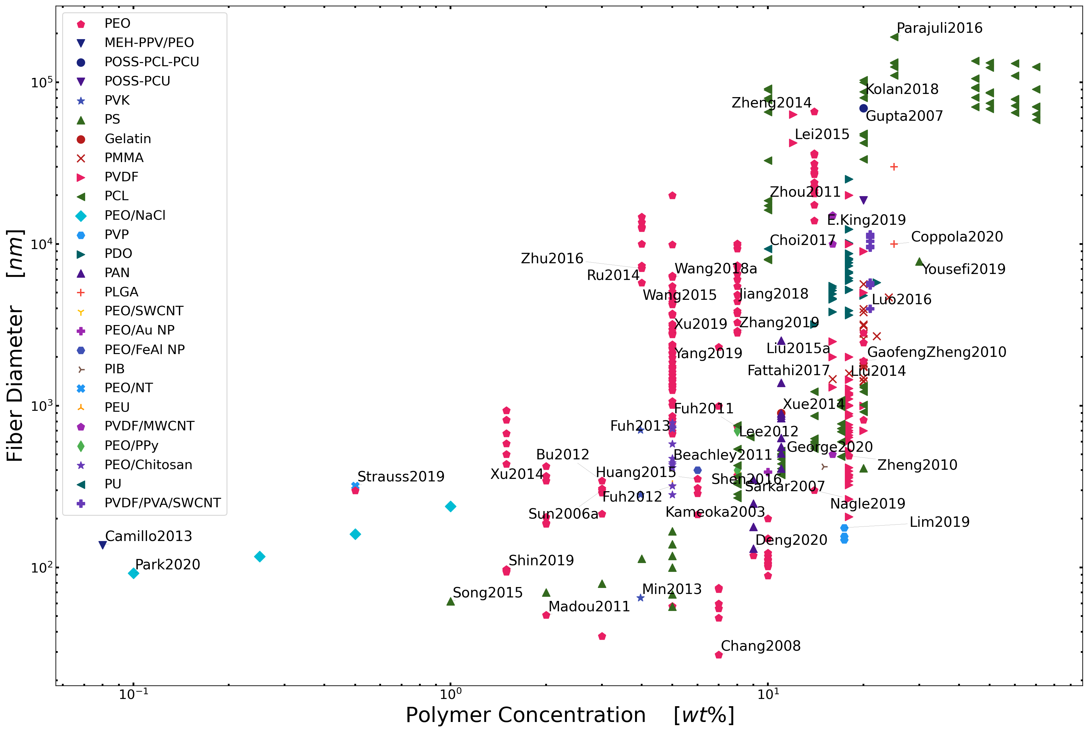
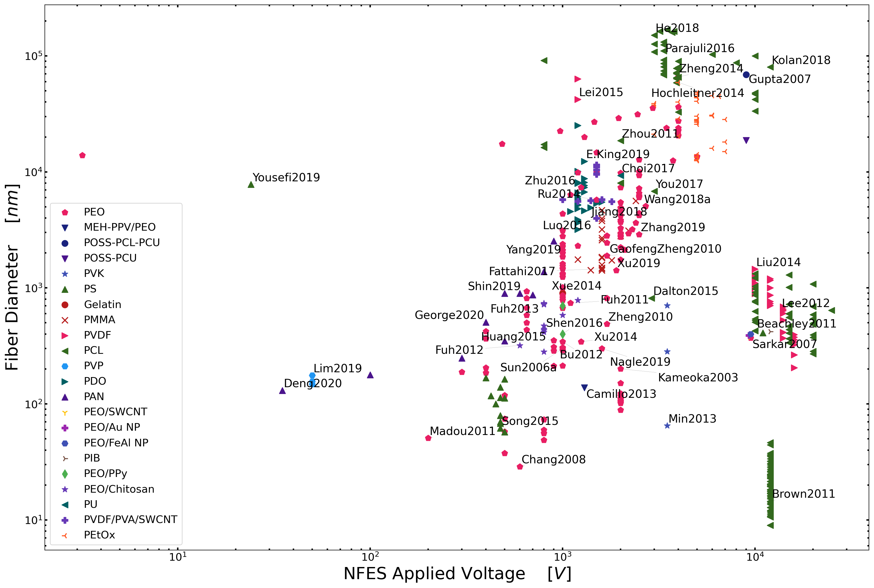
Conclusion 1.2: Let’s focus on polymer concentration
Polymer concentration is the most reliable process parameter to control the morphology of electrospun fibers. (regardless the type of NFES process)

Slide 26
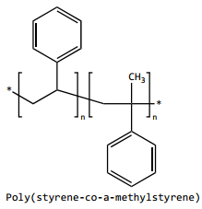
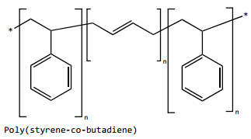
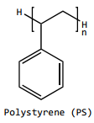
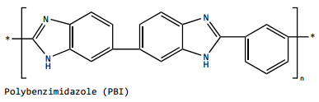
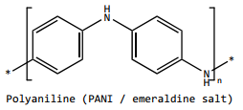
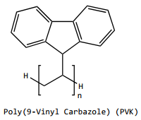
Conclusion1.3: Selection of Polymer-Solvent combinations
Polymers with high carbon content relative to oxygen content
~25 wt% in THF & DMF
(Fong1999)
+15 wt% in DMF
30 wt% in THF (Yousefi2019)
~8 wt% in CHL
No records
No records
A.A. Yousefi, A.R. Mohebbi, S. Falahdoost Moghadam, S.A. Poursamar, L. Hao, Uniaxially aligned microwire networks for flexible transparent electrodes using a novel electrospinning set-up, Sol. Energy. 188 (2019) 1111–1117. ttps://doi.org/10.1016/j.solener.2019.07.007.
H. Fong, D.H. Reneker, Elastomeric nanofibers of styrene-butadiene-styrene triblock copolymer, J. Polym. Sci. Part B Polym. Phys. 37 (1999) 3488–3493. https://doi.org/10.1002/(SICI)1099-0488(19991215)37:24<3488::AID-POLB9>3.0.CO;2-M.

Slide 27
Rheology Analyses
Specific Objective 2. Determine if polymer solutions can be easily employed for conducting carbon nano-wire production through rheological analyses.

Slide 28
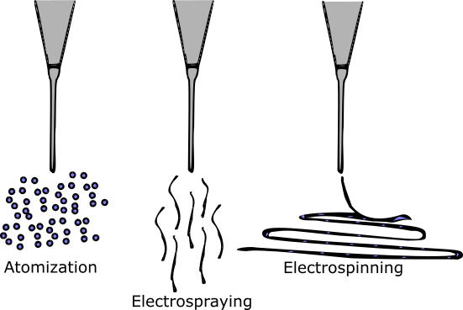
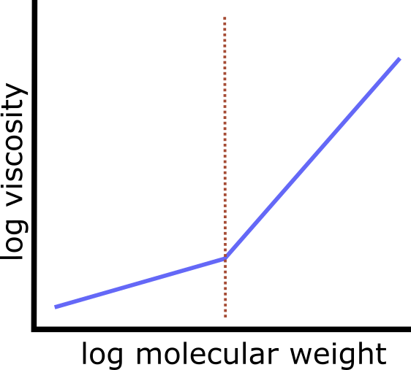
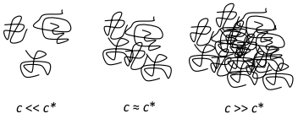
Literature claims
Under some critical concentration NFES yields beads or small fibres
Viscosity increases with molecular weight
Over some critical concentration NFES continuous fibres
The general belief is that the molecular weight needs to be sufficient enough to create or induce entanglements
D.R. Flores, Role of rheological properties in near field electrospun fibers morphology, (2017) 130.
G.L. Wilkes, An overview of the basic rheological behavior of polymer fluids with an emphasis on polymer melts, J. Chem. Educ. 58 (1981) 880. https://doi.org/10.1021/ed058p880.

Slide 29
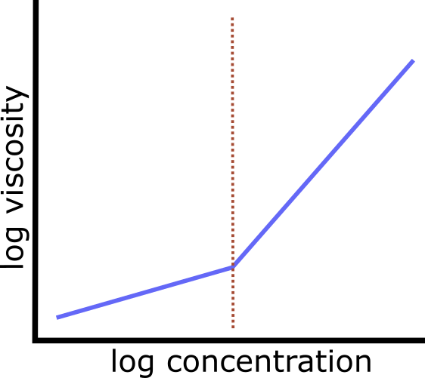
Hypothesis
As “electropunability” is determined by the polymer chain entanglement,
chain entanglement is controlled by molecular weight,
increasing molecular weight increases viscosity, and
viscosity is controlled by polymer concentration, then
The critical/spunable concentration can be found in a viscosity vs. concentration plot
critical
concentration

Slide 30
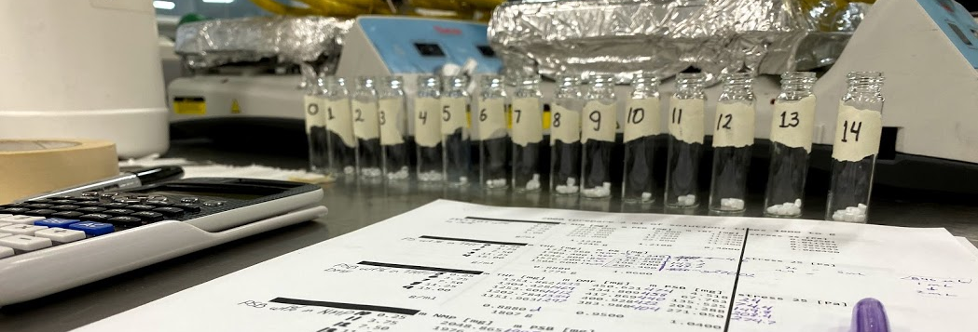
Methods: Sample Preparation (SU8-PEO)
PEO/TBT wt% in SU8 | SU8 [mg] | PEO [mg] | TBT [mg]
0.00 | 1684.5 | 0.000 | 11.28
0.25 | 1684.5 | 4.222 | 11.32
0.50 | 1684.5 | 8.465 | 11.34
0.75 | 1684.5 | 12.729 | 11.37
1.00 | 1684.5 | 17.015 | 11.40
1.5 ml samples
on a heating plate at 200 rpm and room temperature (~24°C), for 3 hours each

Slide 31
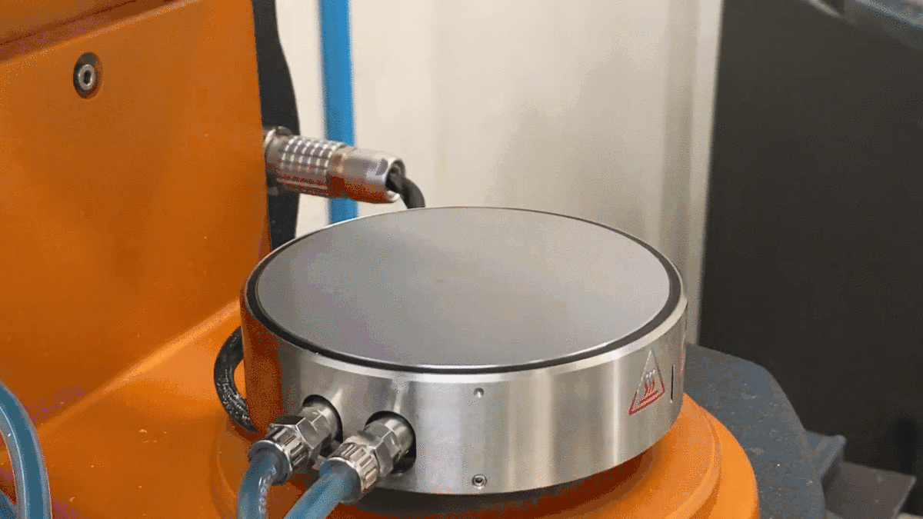
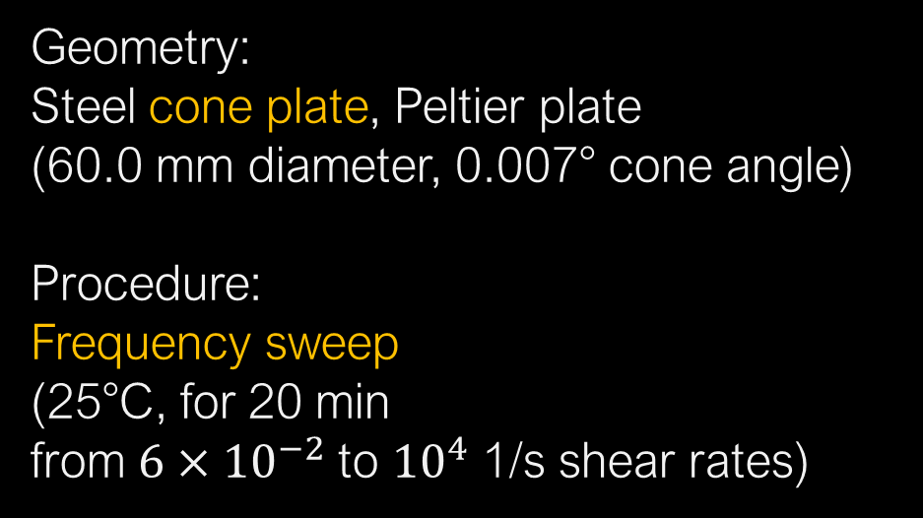
Methods: Rheology – Frequency Sweeps
Geometry:
Steel cone plate, Peltier plate
(60.0 mm diameter, 0.007° cone angle)
Procedure:
Frequency sweep
(25°C, for 20 min
from $6×{10}^{−2}$ to ${10}^{4}$ 1/s shear rates)

Slide 32



Methods: The Carreau-Yasuda Model
$$η=\frac{η_{0}−η_{∞}}{{\left[1+{\left(κ\dot{γ}\right)}^{a}\right]}^{\frac{1−n}{a}}}+η_{∞}$$
$η$: vicosity
$\dot{γ}$: shear rate
$η_{∞}$: infinite shear rate viscosity
$η_{0}$: zero shear rate viscosity
$κ$: time constant
$n$: Power Law index
$a$: width of the transition region

Slide 33


Methods: Rheology results validation

Slide 35
Fabrication & Characterization
Specific Objective 3. Discover a similar PEO-SU8-TBF material to allow the electrospinning process as well as input favourable properties to the carbon nanowire yield.

Slide 36

POLY(ETHYLENE OXIDE)
SU-8
successful NFES fibres

Slide 37

POLY(STYRENE-CO-BUTADIENE)
1-METHYL-2-PYRROLIDINONE
successful NFES fibres

Slide 38

POLYSTYRENE
TETRAHYDROFURAN
successful NFES fibres

Slide 39

POLY(STYRENE-CO-ALPHA-METHYLSTYRENE)
N,N-DIMETHYLFORMAMIDE
non-spunable concentrations
spunable concentrations

Slide 40


Notes:
D.R. Flores, Role of rheological properties in near field electrospun fibers morphology, (2017) 130.

Slide 41

Notes:
D.R. Flores, Role of rheological properties in near field electrospun fibers morphology, (2017) 130.

Slide 42

Notes:
D.R. Flores, Role of rheological properties in near field electrospun fibers morphology, (2017) 130.

Slide 43

Flow curves
Notes:
D.R. Flores-hernandez, B. Cardenas-benitez, S.O. Martinez-chapa, J. Bonilla-rios, Tailoring the Diameters of Electro-Mechanically Spun Fibers by Controlling Their Deborah Numbers, (2020). https://doi.org/10.3390/polym12061358.

Slide 44

Zero-shear viscosity at 1wt% PEO
Around 10^2 Pa.s
D.R. Flores
(in SU8 and 0.5 wt% TBT)
(in SU8 and 0.5 wt% TBT)
G.S. Bisht
(in water)
Notes:
G.S. Bisht, G. Canton, A. Mirsepassi, L. Kulinsky, S. Oh, D. Dunn-Rankin, M.J. Madou, Controlled Continuous Patterning of Polymeric Nanofibers on Three-Dimensional Substrates Using Low-Voltage Near-Field Electrospinning, Nano Lett. 11 (2011) 1831–1837. https://doi.org/10.1021/nl2006164.

Slide 45

vs. MicroChem
(in SU8 and 0.5 wt% TBT)
eta_0 -> 0.0986 eta_inf -> 0.0093
vs. 0.00842 Pa.s
Notes:
G.S. Bisht, G. Canton, A. Mirsepassi, L. Kulinsky, S. Oh, D. Dunn-Rankin, M.J. Madou, Controlled Continuous Patterning of Polymeric Nanofibers on Three-Dimensional Substrates Using Low-Voltage Near-Field Electrospinning, Nano Lett. 11 (2011) 1831–1837. https://doi.org/10.1021/nl2006164.

Slide 46

D.R. Flores, Role of rheological properties in near field electrospun fibers morphology, (2017) 130.
http://www.rheologyschool.com/advice/rheology-glossary

Slide 47
Conclusions:
<Conclusion A>
<Conclusion B>

Slide 48


Slide 49
Conclusions:
<content> <key concept> <key concept>

Slide 50


SU-8 (MicroChem, US)
Notes:
https://rsc.aux.eng.ufl.edu/_files/msds/309.pdf

Slide 51
Carbon nanostructures via Lithography
The production of C-MEMS:
Polymer patterning through photolithography electrospinning
Carbonization through pyrolysis
● SU-8 Waste
● Physical & Optical Limitations
● Structure Limitations
photolithography process

Slide 52

TPP – Two-Photon Polymerization
B. Cardenas-Benitez, C. Eschenbaum, D. Mager, J.G. Korvink, M.J. Madou, U. Lemmer, I. De Leon, S.O. Martinez-Chapa, Pyrolysis-induced shrinking of three-dimensional structures fabricated by two-photon polymerization: experiment and theoretical model, Microsystems Nanoeng. 5 (2019). https://doi.org/10.1038/s41378-019-0079-9.

Slide 53


Characterization of the 0.25 wt% PEO Solution
Notes:
Surface t-

Slide 54


Slide 55






25 wt% in THF & DMF
15 wt% in NMP
15 wt% in DMF
35 wt% in THF
8 wt% in CHL
7 wt% in DCM

Slide 56



Slide 57



Characterization of the 0.25 wt% PEO Solution
Electrospun-able with an applied voltage of 600V.
Unable to initiate the jet at 500V or lower.
600V
700V
Notes:
Surface t-

Slide 58




Slide 59



Slide 60
PEO Solution
The EMS polymer solution consisted of
2ml of SU-8 2002 mixed with
0.5 wt% of Poly(ethylene oxide) (PEO, 4,000,000 MW; SigmaAldrich Inc., Cat. N. 189464) and
0.5 wt% Tetrabutylammonium Tetrafluoroborate salts (TBATFB; SigmaAldrich Inc., Cat. N. 217964) to increase its conductivity and allow smooth polymer flow during electrospinning.
All reagents were used as received. Magnetic stirring of these components was performed for 1hr at 75°C and low rpm (100-150 rpm).

Slide 61
SU-8 (MicroChem, US)
Notes:
https://rsc.aux.eng.ufl.edu/_files/msds/309.pdf

Slide 62



SU-8 (MicroChem, US)
https://www.fishersci.com/shop/products/NC9901158/nc9901158#?keyword=SU-8++developer
https://www.fishersci.com/shop/products/NC0702370/nc0702370#?keyword=MICROCHEM+CORP+PHOTORESIST+SU-8
Notes:
https://rsc.aux.eng.ufl.edu/_files/msds/309.pdf

Slide 63

Materials

Slide 64
References
<reference A>
<reference B>

